Slide 1

Software Testing & Quality (10)
Testing the Documentation

Slide 2
Highlight
Distinguish between system & user documentation
Types of Software Documentation
The Importance of Documentation Testing
What to Look for when Reviewing Documentation
The Realities of Documentation Testing

Slide 3

Components of a Software
Setup
Samples And Examples
Readme file
Help Files
Label and Stickers
Advertisements
Final Product
Users Manuals
Error Messages
Product Support Information
Samples

Slide 4
Distinguish between system & user documentation
Two audiences for documentation
  The information systems personnel who will maintain the system throughout its productive life
  The people who will use the system as part of their daily lives
System Documentation
  Detailed information about a system’s design specs, its internal workings, and its functionality
User Documentation
  Written or visual information about an application system, how it works, and how to use it

Slide 5
Documentation Types
Types of Documentation
  Considering the Audience
  User’s Manuals
  Operator’s Manuals
  General System Guide
  Tutorials and Automated System Overviews
  Other system Documentation
User help and Troubleshooting
  Failure Message Reference Guide
  Online Help
  Quick Reference Guides

Slide 6








More Types of Documentation
Package text and graphics
Marketing material, ads and other inserts
Warranty/Registration(sign up)
EULA ( End User License Agreement)
Labels and stickers
Samples, example and template

Slide 7
User Manuals
System Summary:
  The system’s purpose or objectives
  The system’s capabilities and functions
  The system’s features, characteristics, and advantages, including a clear picture of what the system accomplishes
Manual functional description:
  A map of the major functions and how they relate to one another
  Each function in terms of the screens the user can expect to see, the purpose of each, and the result of each menu choice or function key selection
  All input expected by each function
  All output that can be created by each function
  The special features that can be invoked by each function

Slide 8
Failure Message Reference Guide
The name of the code component executing when the failure occurred
Source code line number in the component that was executing
Failure severity and its impact on the system
Contents of any relevant system memory or data pointers, such as registers or stack pointers
Nature of the failure, or a failure message number

Slide 9
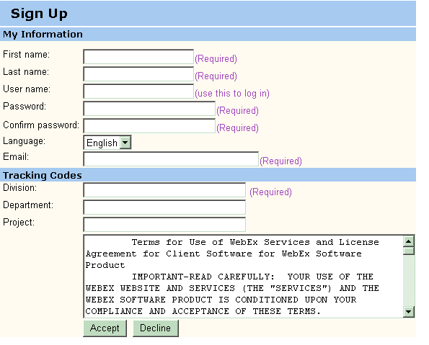
Registration

Slide 10
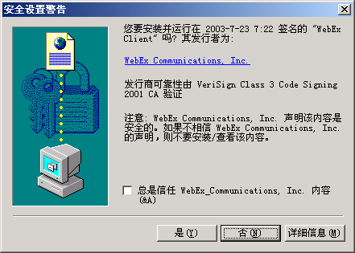
EULA
End User License Agreement

Slide 11
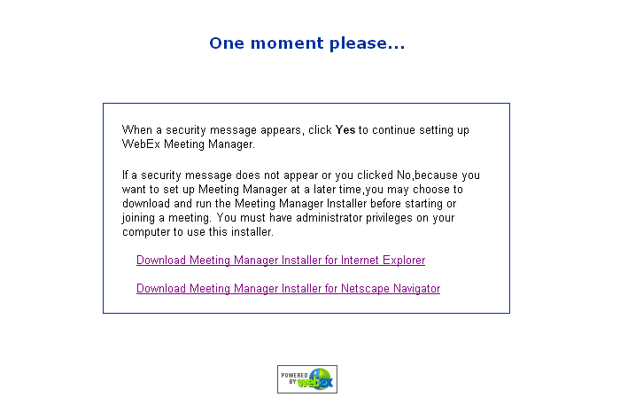
Installation and setup instructions

Slide 12
Importance of Documentation Testing
Good documentation contributes to the product’s overall quality in three ways:
  It improves usability
  It improves reliability
  It improves support costs
To uncover documentation fault, documentation checking is needed

Slide 13
What to Look for when Reviewing Documentation
What Makes Good documentation?
Documentation testing Criteria
A Documentation testing Checklist

Slide 14
What Makes Good documentation
Good user documentation includes:
  A glossary for unusual terminology
  Error messages, troubleshooting, and recovery information
  Index of key topics
  a detailed table of contents
Good to outline the documentation first, and make sure key functions are accounted for
Contains task-based documentation
  “How to’s…”
  Frequently Asked Questions
  Messages & their meanings
  Samples and examples
Documentation should use short, simple paragraphs and sentences

Slide 15
Documentation testing Criteria
Documentation Testing is conducted to ensure
  Correctness,
  Completeness,
  Understandability
It is to justify that all document is up-to-date with respect to model logic specification

Slide 16
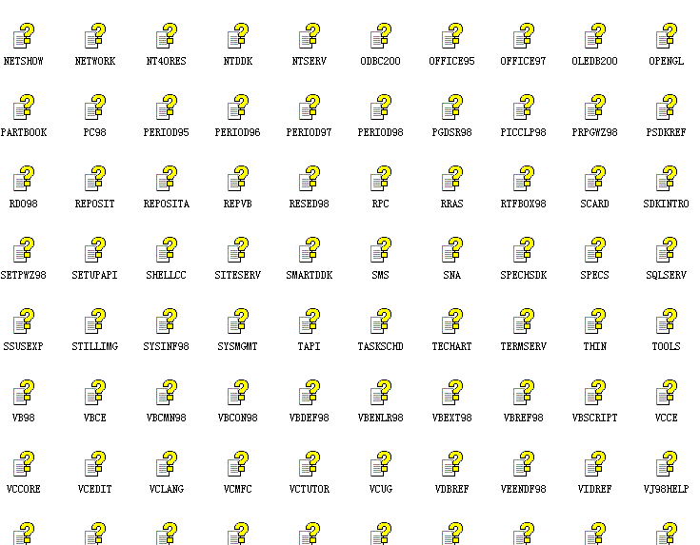
Documentation testing Checklist
General Areas
  Audience
  Terminology
  Content and Subject matter
Correctness
  Just the facts
  Step by Step
  Figures and screen captures
  Samples and examples
  Spelling and grammar
Microsoft is Microsoft

Slide 17
Realities of Documentation Testing
What make documentation development and testing a bit different from software development:
  Documentation often gets the least attention, budget and resource
  Documentation developers are not experts in software
  Printed documentation takes time to produce

Slide 18
Exercise
Software Testing, Page 197: 2, 4
  The Windows Paint Help Index contains more than 200 terms from airbrush tool to zooming in or out. Would you test that each of these takes you to the correct help topics? What if there were 10,000 indexed terms?
  In what three ways does good documentation contribute to the product's overall quality?

